Slide 1
Migration Training
Day 3

Slide 2
Agenda
Assess and Discovery
Landing Zone
Migration Waves Planning
Server Migration
Cutover
Pipeline Migration
Disaster Recovery

Slide 3
Migration Assessment & Discovery

Slide 4
Assess Phase in Migration
Definition:
The Migration Assessment phase is about understanding your current environment before moving anything
to the cloud.
Why It’s Important:
Assessment helps identify what needs to be migrated, potential risks, and the best strategy to ensure a
smooth migration.
What It Involves:
This phase includes discovering existing servers, databases, and applications, and checking for
compatibility with the new environment.

Slide 5

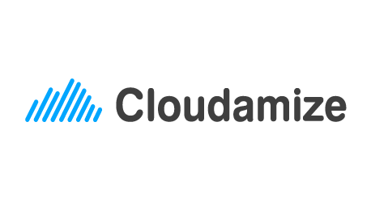
Discovery
Discovering environment with:
Agentless Collector: Utilizing centralized tools or scanning mechanisms that communicate with target systems over the network without requiring agent installations.
Agent Based: Agents installed on individual servers within the on-premises environment will gather information about hardware, software, configurations, and other dependencies.
Discovery tools:

Slide 6
Outcome of Assessment Phase
A comprehensive understanding of the existing on-premises environment, applications, and infrastructure. This phase involves gathering data, analyzing workloads, and assessing the organization's readiness for migration to the cloud.
The key outcomes of the Assess Phase include:
Current State Analysis
Workload Assessment
Risk and Readiness Assessment
Cost Estimation

Slide 7
Mobilize Phase

Slide 8
Landing Zone – Where to migrate?
A landing zone is a well-architected, multi-account environment that is scalable and secure. This is a starting point from which organization can quickly launch and deploy workloads and applications.
Landing Zone helps in setting up:
Security Assurance
Centralized Network Setup
Multi-Account Setup
Governance and Compliance
Centralized identity and access management
Centralized Logging

Slide 9
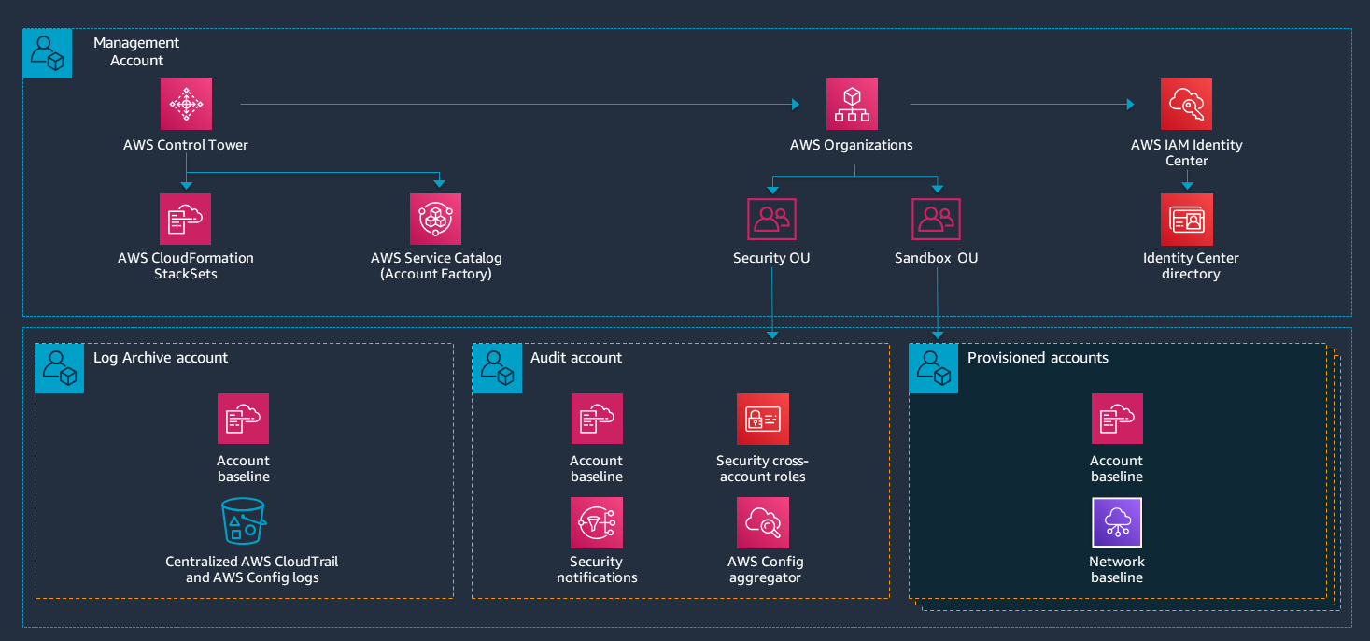
LZ Architecture - AWS

Slide 10
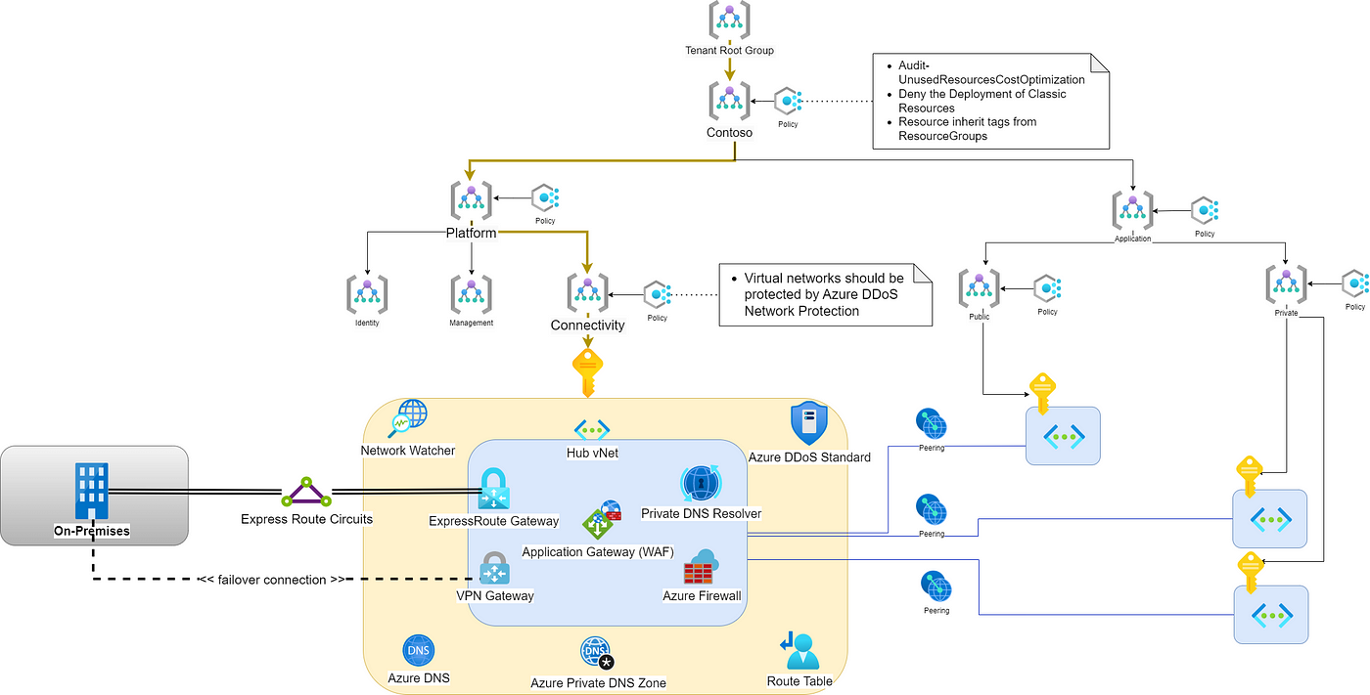
LZ Architecture - Azure

Slide 11
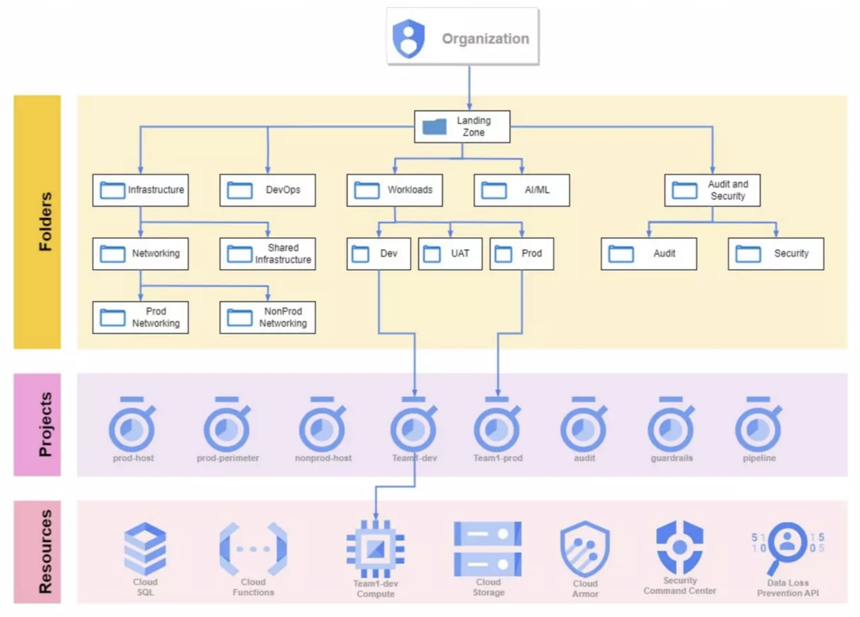
LZ Architecture - GCP

Slide 12
LZ Reference Links
AWS:
https://docs.aws.amazon.com/prescriptive-guidance/latest/migration-aws-environment/welcome.html
Azure:
https://learn.microsoft.com/en-us/azure/cloud-adoption-framework/ready/landing-zone/
GCP:
https://cloud.google.com/architecture/security-foundations/printable
3 Phases of Migration:
https://aws.amazon.com/cloud-migration/how-to-migrate/

Slide 13
Wave Planning (Mobilize)

Slide 14
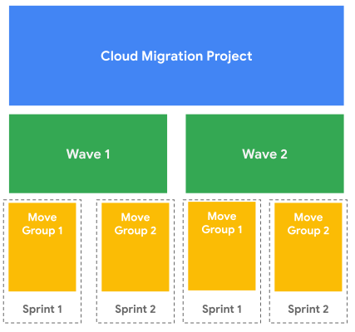
Wave Planning – What to migrate?
Wave plan for migration: Organizing the migration process into waves or phases based on the factors like,
Application dependencies,
Criticality,
Business constraints,
Technical constraints.

Slide 15
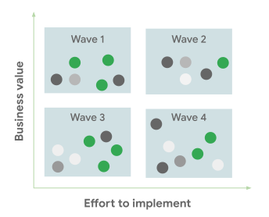
Grouping of Applications in Waves
Group applications into multiple waves with timelines
Associated with each wave, along with the time to revise
plans based on the feedback from each wave.
Wave 1: High business value, low effort to implement.
Wave 2: High business value, high effort to implement.
Wave 3: Low business value, low effort to implement.
Wave 4: Low business value, high effort to implement.

Slide 16
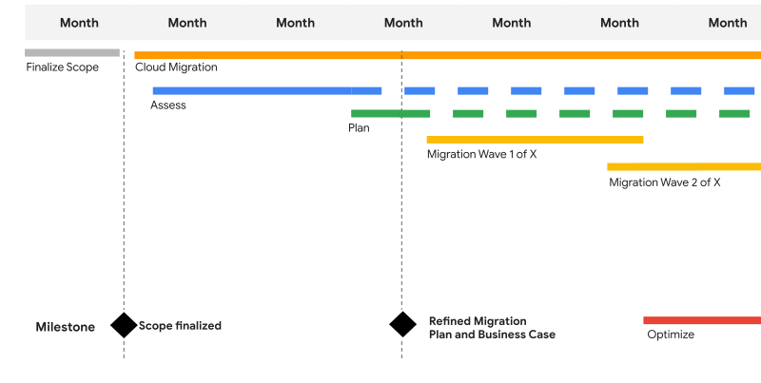
Wave Plan - Sample

Slide 17
Server Migration Cloud native Tools

Slide 18
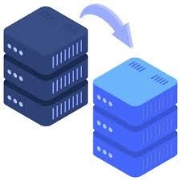
Infrastructure Migration
What is Infrastructure Migration?
The process of moving an organization's existing IT infrastructure including websites, applications, data, and systems from an on-premises environment or another hosting solution to another Data Center or a cloud provider like AWS, Azure, or GCP.
Aimed at improving performance, scalability, security, and cost efficiency.
Can be considered the hardware or systems migration counterpart to software and data migrations.

Slide 19
Reason For Server Migration
Hardware Limitations or Faults: Older or damaged hardware may no longer meet performance needs.
Upgrading Technology: Adopting newer technologies for improved functionality, flexibility, and scalability.
Cost Savings: Consolidating servers or optimizing resources to reduce costs.
Geographic Expansion: Moving servers closer to users in new regions to reduce latency and improve performance.

Slide 20
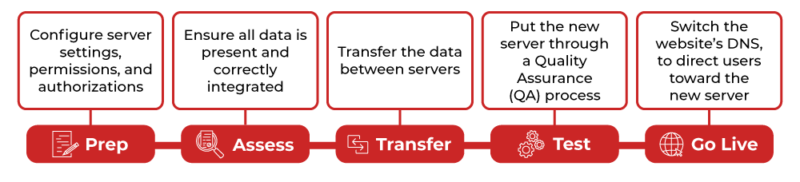
How to Migrate Servers?
Step 1: Prepare the Target Server
Configure settings, permissions, and authorizations.
Consider server size, performance, scalability, and new technologies.

Slide 21
How to Migrate Servers?
Step 2: Assess Data Fidelity
Account for all data, ensuring quality and proper integration.
Plan for data protection and compliance with laws.
Step 3: Transfer the Data
Secure data transfer between servers.
Communicate with stakeholders to avoid miscommunication during the process.
Step 4: Validation
Test the new server for performance and processing issues.
Document the process and results for future reference.

Slide 22
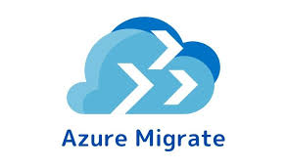
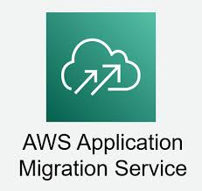

How to Migrate Servers?
Step 5: Change DNS, Go Live
Switch the website's DNS to point to the new server.
Ensure backups are available in case of issues.
Cloud Tools Used For Server Migration:
GCP Migrate to VM

Slide 23
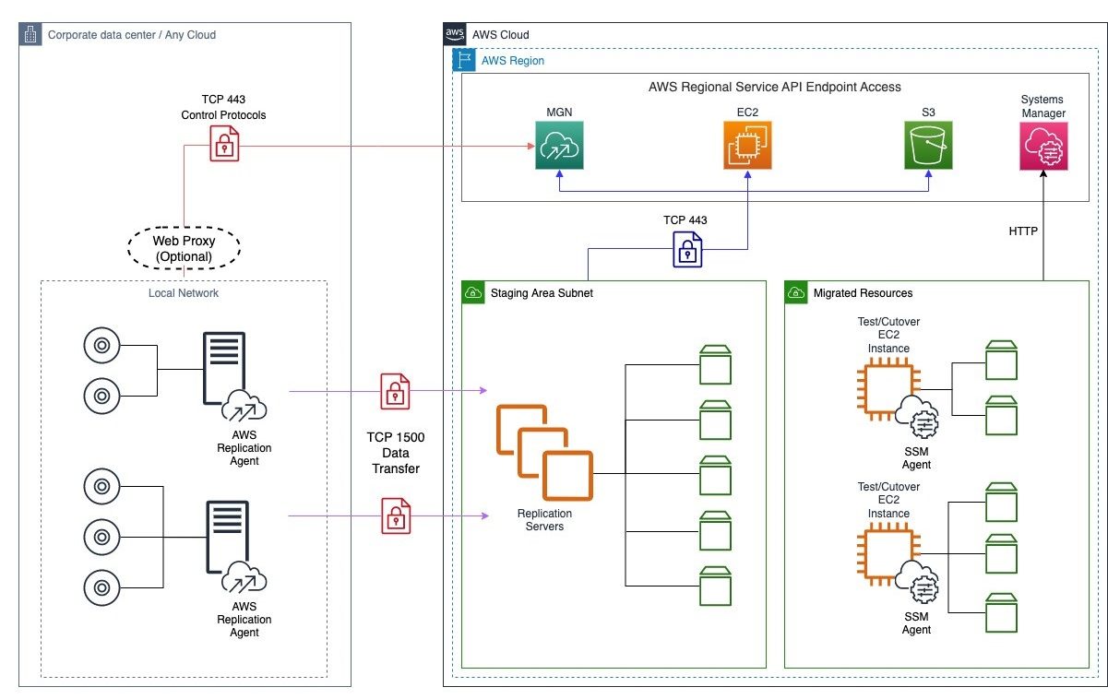
AWS MGN

Slide 24
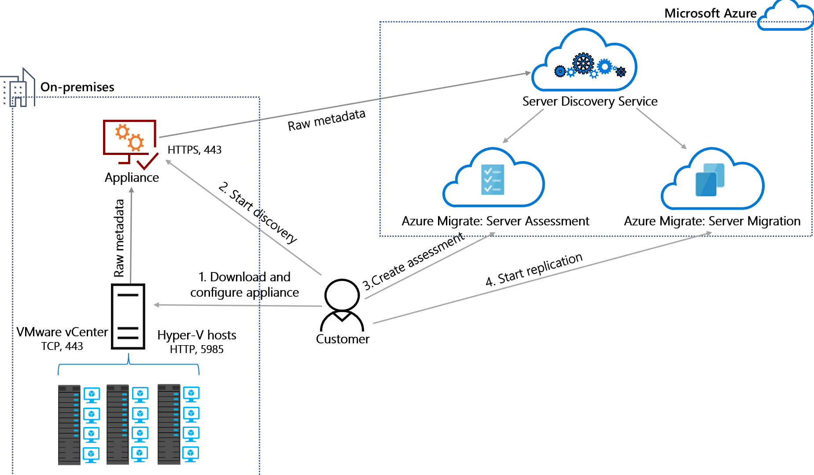
Azure Migrate

Slide 25
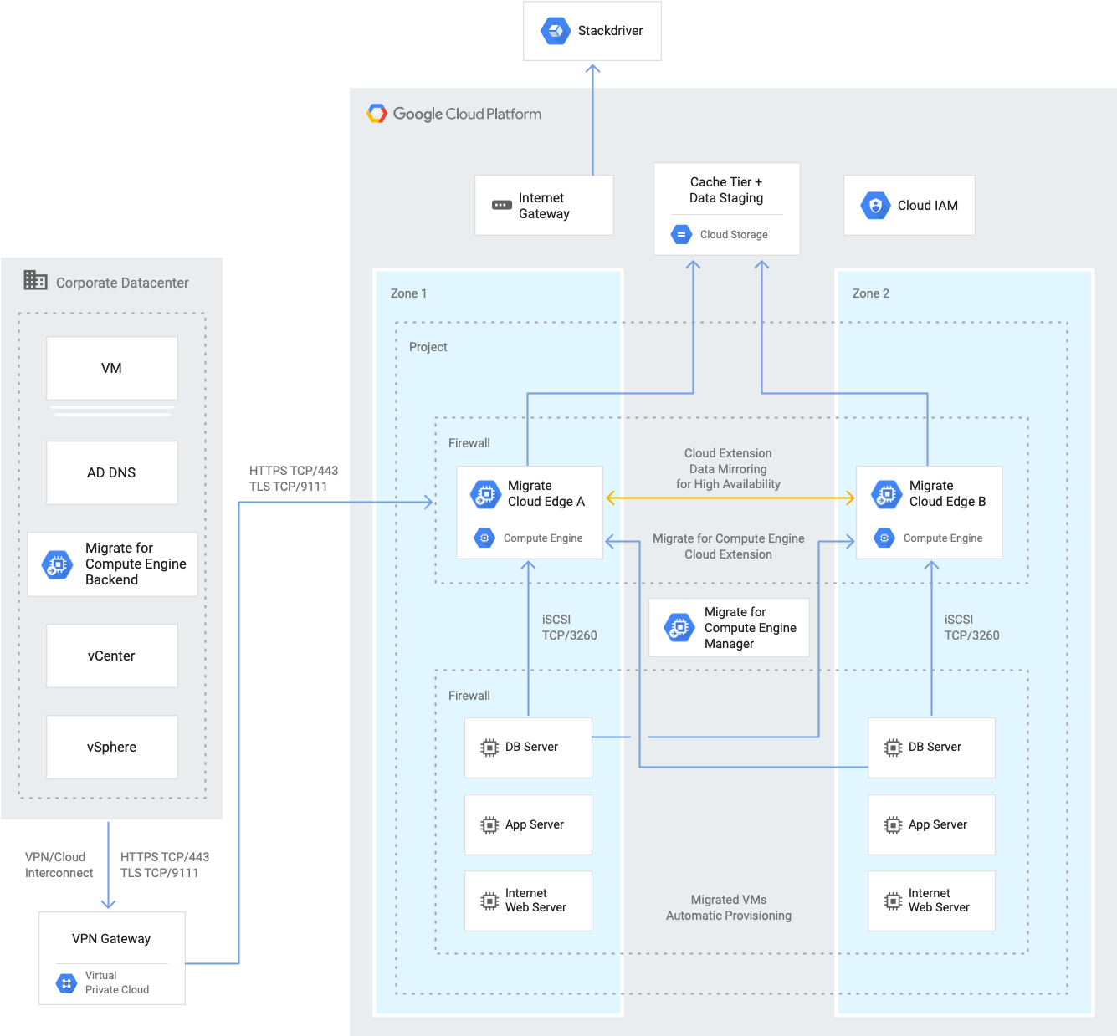
GCP Migrate

Slide 26
Cut Over
The cutover is the moment when the final switch is made from the old system to the new system. It marks the transition from testing and preparation to live operation on the new platform.
When It Happens:
End of the Final Wave:
After all critical systems have been migrated and tested successfully.
When stakeholders have validated the new environment.
During a planned maintenance window to minimize business disruption.

Slide 27
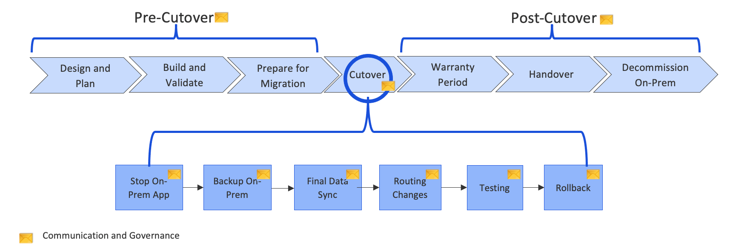
Cut Over
Key Considerations:
- Minimizing Downtime: Ensure that the cutover is planned during low-traffic periods.
- Rollback Plan: Have a contingency plan in case the cutover encounters issues.
- Communication: Inform all stakeholders about the cutover timing and any expected impacts.

Slide 28
Pipeline Migration

Slide 29
What is a Pipeline ?
A pipeline is a series of automated steps that are used to build, test, and deploy software applications.
This help developers ensure that their code is reliable, and that new features or updates can be quickly
and safely delivered to users.
Basic Components:
- Build: Compiling the code, Installing necessary dependencies and preparing it for deployment.
- Test: Running tests to ensure the code works as expected.
- Deploy: Releasing the application to a production or staging environment.

Slide 30
Pipeline Migration
Pipeline migration is the process of moving automated CI/CD pipelines from one environment, tool, or
platform to another. This could involve transitioning pipelines between different cloud providers, CI/CD
tools, or upgrading to a newer system within the same environment.
Key Aspects:
- Reconfiguration: Adjusting the pipeline's settings and scripts to fit the new environment or tool.
- Validation: Ensuring that the migrated pipeline functions correctly and meets the desired performance standards.
- Optimization: Leveraging new features or capabilities in the target environment to improve efficiency and reliability.

Slide 31
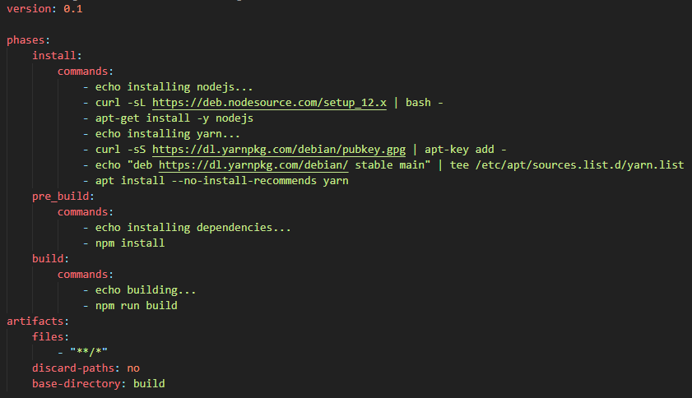
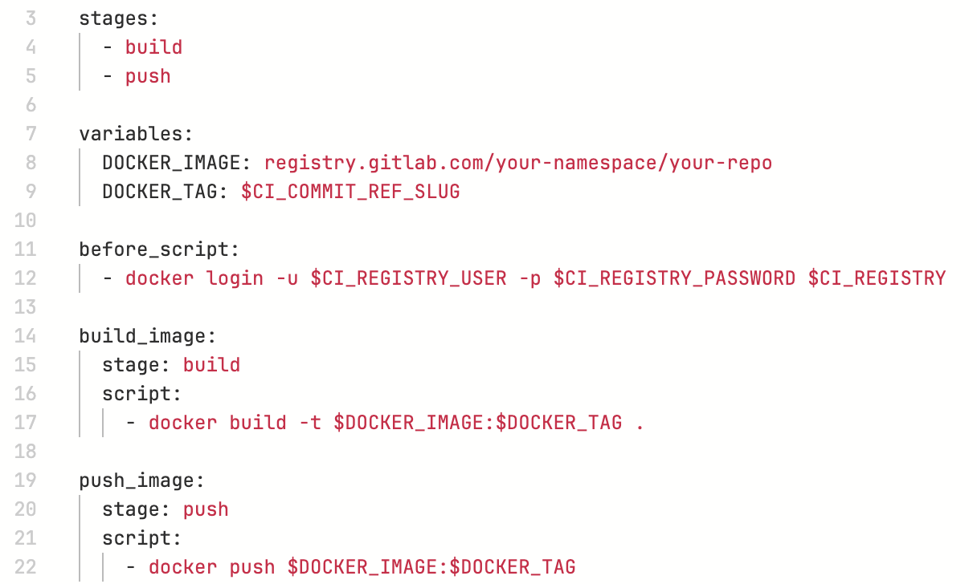
Pipeline Migration – Example Templates
CodePipeline Template
Gitlab Template

Slide 32
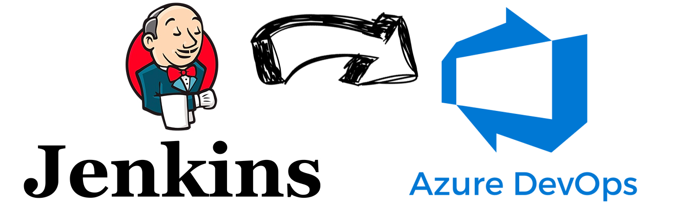
Need for Pipeline Migration
Features: If a new feature or functionality is required that your current pipeline tool doesn't support, migration might be necessary to gain those capabilities.
Cost: To reduce expenses, you might migrate to a more cost-effective pipeline tool that offers similar or better functionality at a lower price.
Partnerships: Sometimes, companies or clients have agreements or partnerships that require the use of specific CI/CD tools. In these cases, migration ensures compliance with these agreements.

Slide 33
Types of Pipeline Migration
Between Platforms: Sometimes, you need to move your pipeline from one platform to another because you need new features, want to save money, or need to follow certain agreements.
Platform Upgrade: You might upgrade your current platform to get better features.
- For example: Moving from GitLab's free version to its premium or ultimate versions.
Unifying Templates: If you have many pipelines that do similar things, or you want to add the same code scanning or testing to all of them, you can create a shared template. This way, you don't have to copy the same code or secrets into each pipeline.

Slide 34
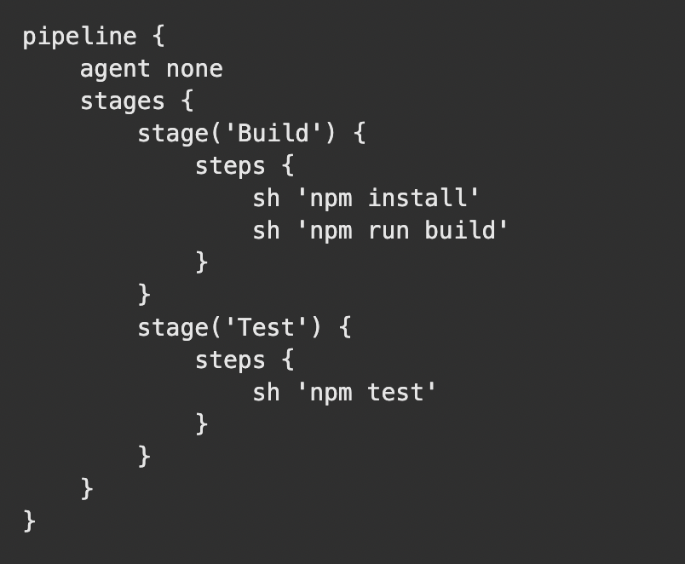
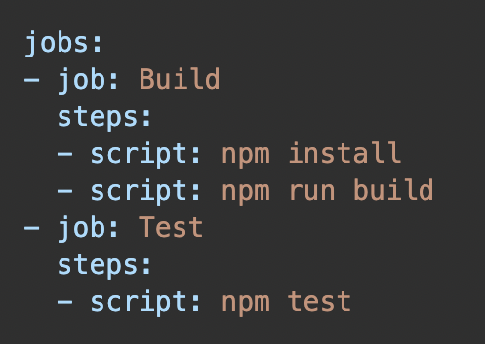
Between Platforms - Pipeline Migration
Scenario: Jenkins to Azure Devops Pipeline
Reason: Applications are moved to Azure, allowing for easy native tool integration. Azure DevOps offers free self-hosted agents, while Jenkins requires setting up and paying for agents on VMs.
Jenkins Template
AzDevOps Template

Slide 35
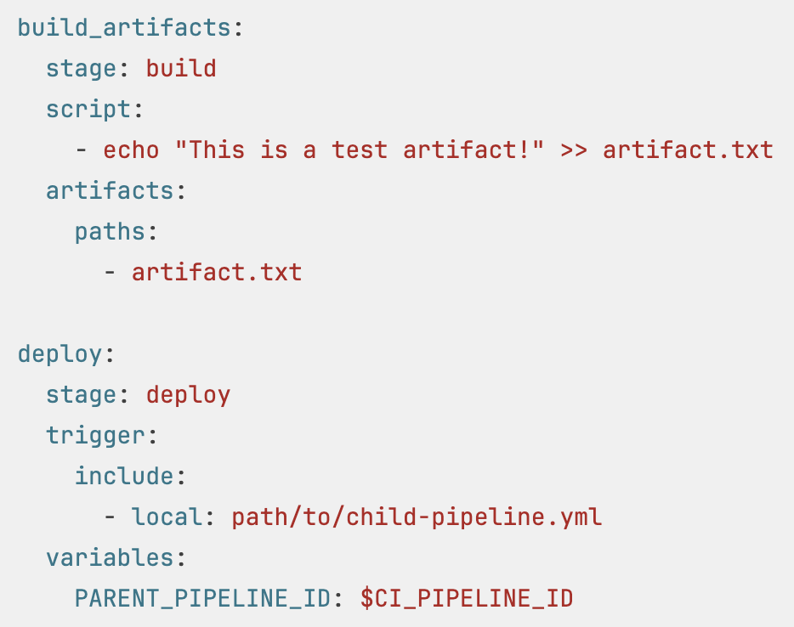
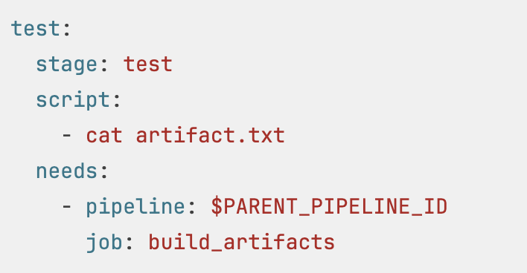
Platform Upgrade - Pipeline Migration
Scenario: Gitlab Free to Gitlab Premium
Reason: Data team needs to validate all the artifacts generated from the Upstream pipeline which should be available to downstream pipelines this feature not available in gitlab free version.
Upstream Pipeline
Downstream Pipeline

Slide 36
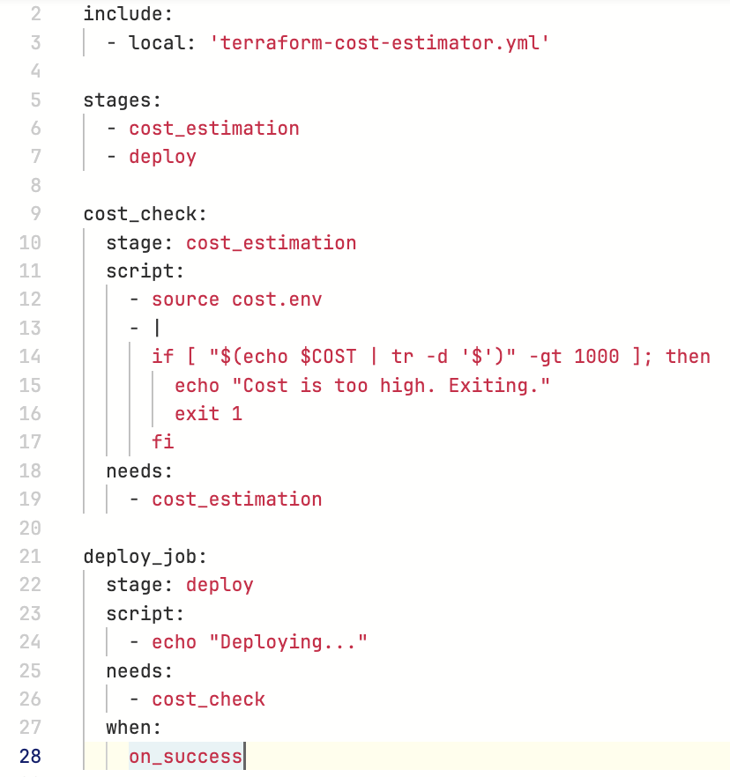
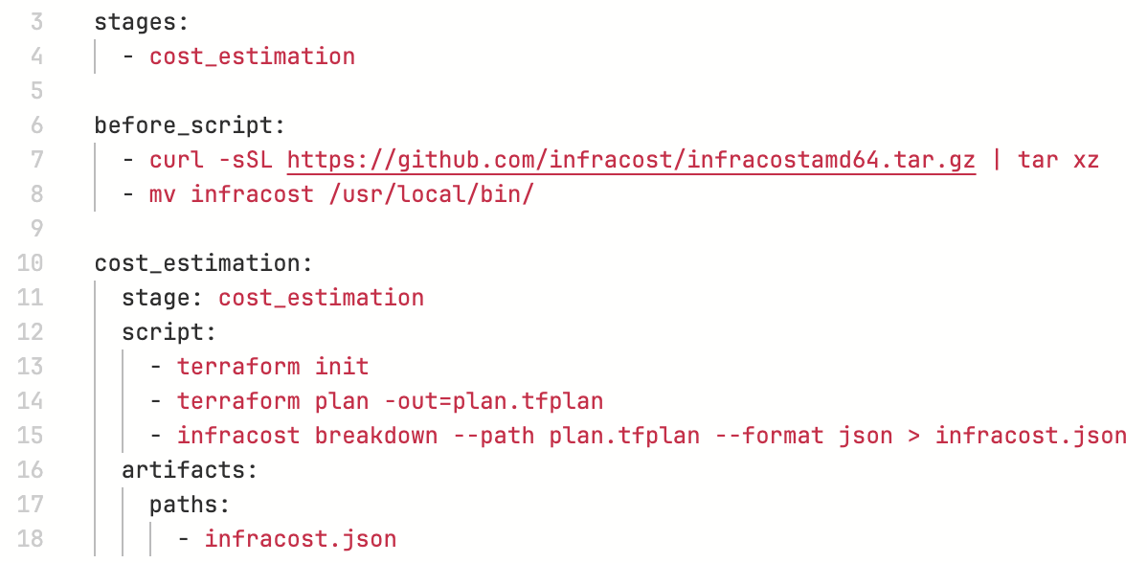
Unifying Template - Pipeline Migration
Scenario: Adding Infra Cost Scanner to Terraform Pipelines
Reason: To find the cost of all the resources that are being deployed. Based on the infra cost we can stop the pipeline from deploying.
Infra Cost scanning Template
Inclusion Template

Slide 37
Disaster Recovery

Slide 38
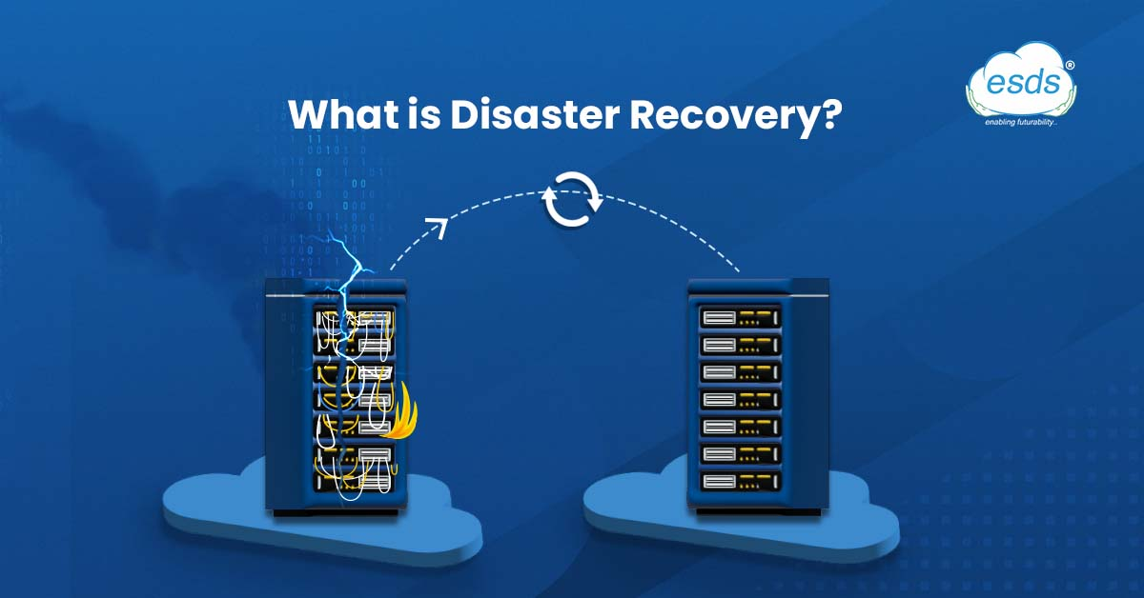
Disaster Recovery
The process of preparing for and recovering from any event that prevents a workload or system from fulfilling its business objectives in its primary deployed location, such as power outages, natural events, or security issues.

Slide 39
Why DR should be Implemented?
Ensures business continuity
Enhances system security
Reduces recovery costs and time
To Avoid Data loss
To Ensure High availability
Improves customer retention

Slide 40
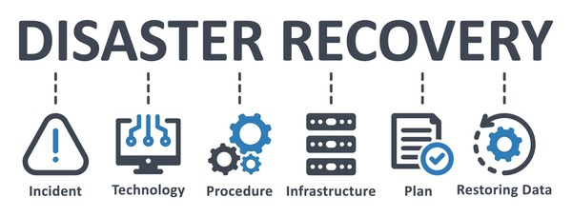
Types of DR
Backup: Regularly saving data to enable recovery in case of loss.
Disaster Recovery as a Service (DRaaS): Cloud-based solution that replicates and hosts data and applications for quick recovery.
Virtualization: Creating virtual versions of physical resources to improve flexibility and recovery speed.
Disaster Recovery Sites: Offsite locations equipped to restore operations and data in case of a disaster.

Slide 41
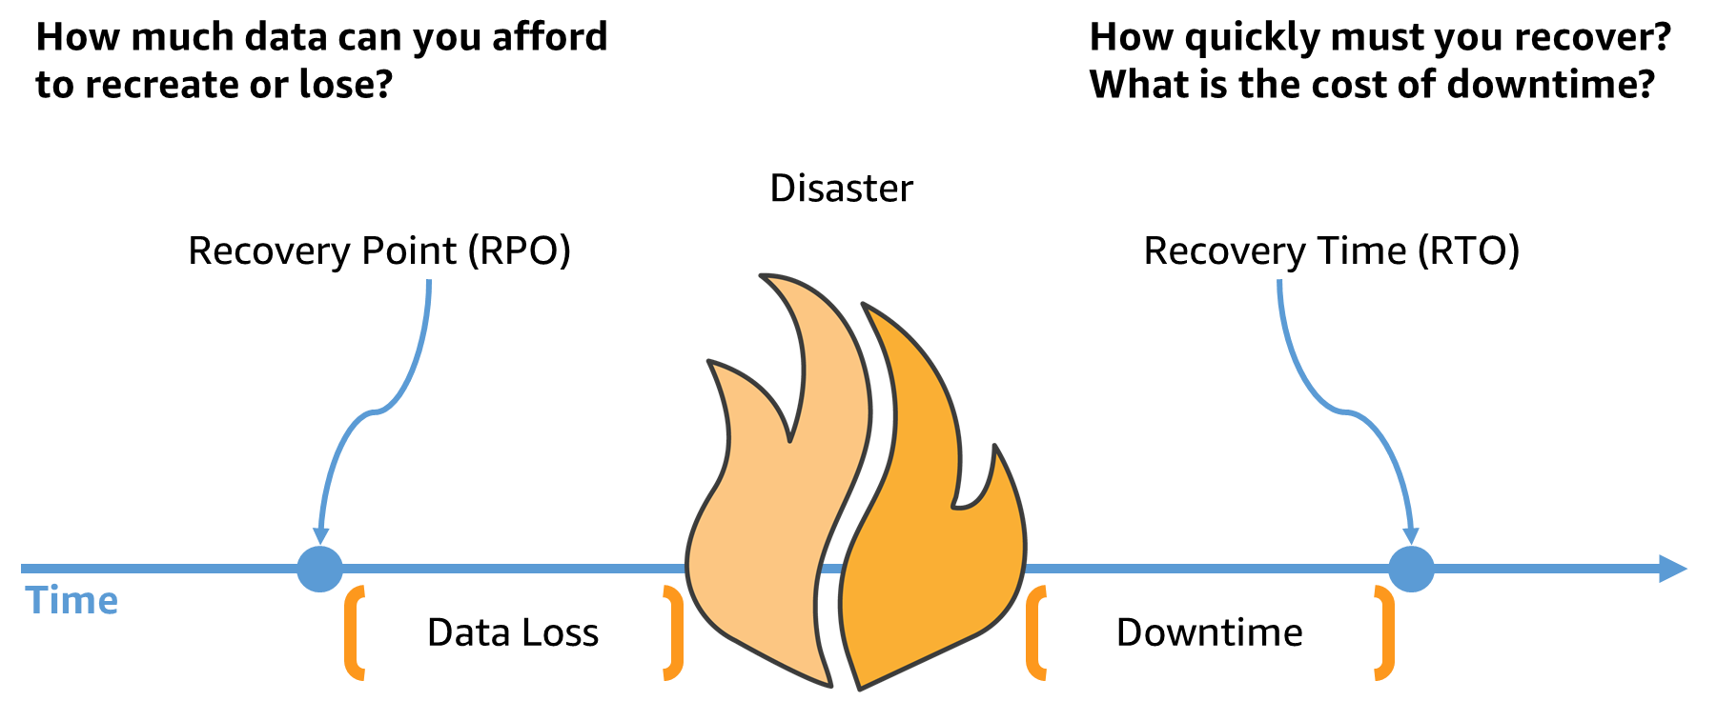
Key metrics of DR plan

Slide 42
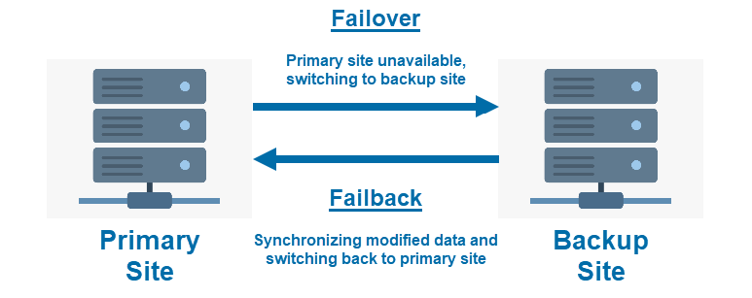
Failover and Failback

Slide 43
Disaster Recovery Architecture (cloud native)

Slide 44
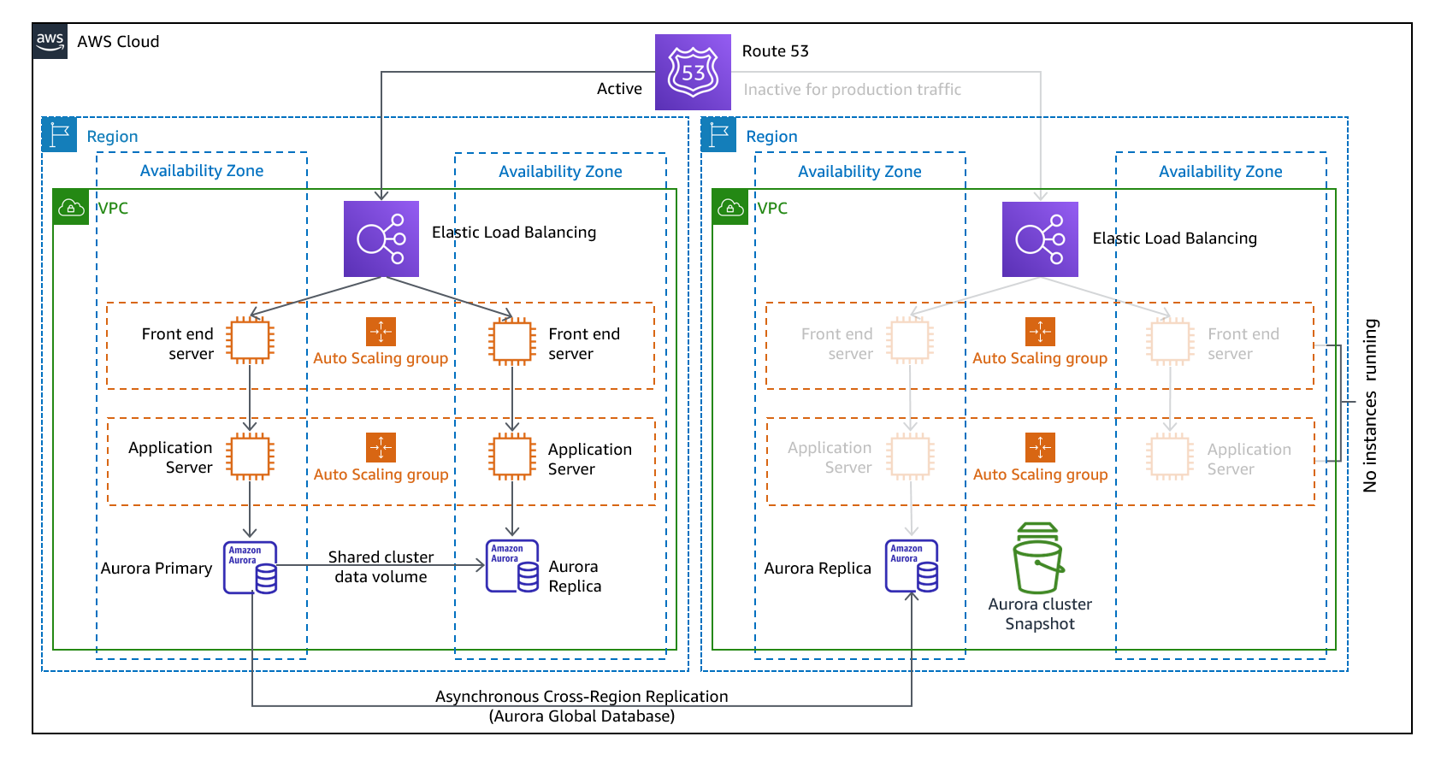
DR Architecture - AWS

Slide 45
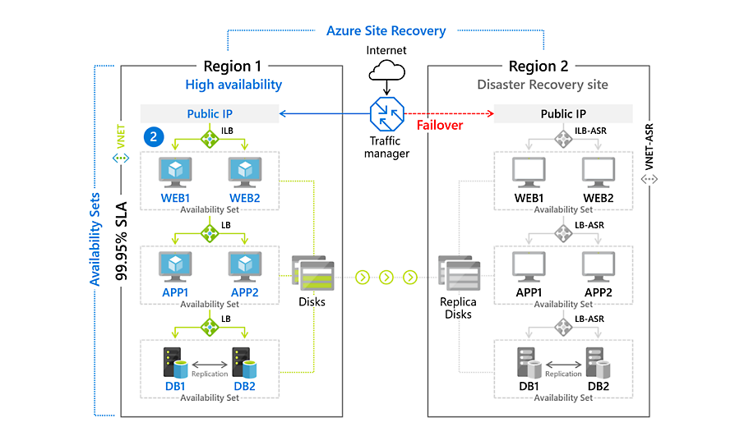
DR Architecture - Azure

Slide 46
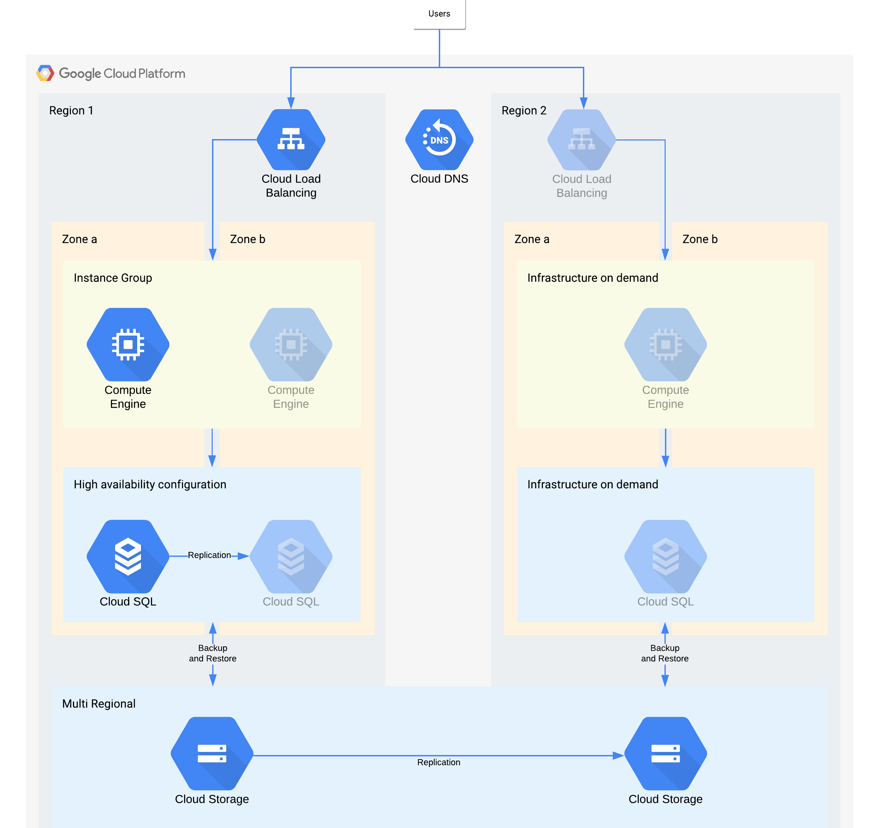
DR Architecture - GCP

Slide 47
Cloud Based DR Services

Slide 48
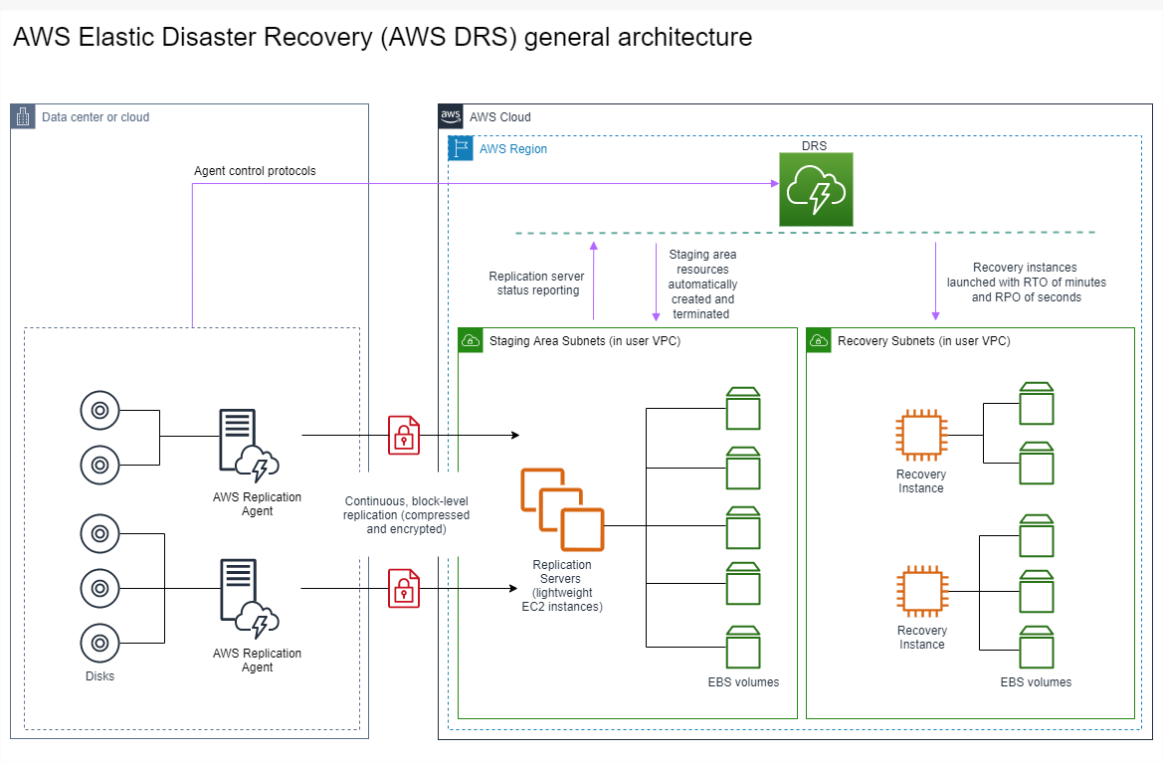
AWS Elastic Disaster Recovery Service(DRS)
AWS DRS uses lightweight agents installed on your source servers (on-premises or cloud) to replicate data continuously to AWS at the block level.

Slide 49
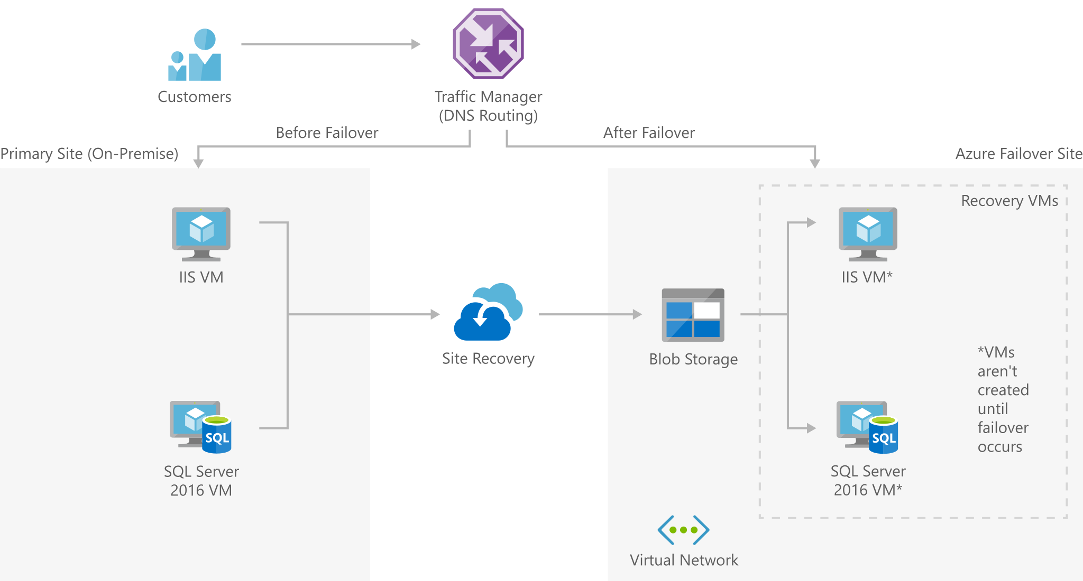
Azure Site recovery and backup
Site Recovery replicates workloads running on physical and virtual machines (VMs) from a primary site to a secondary location

Slide 50
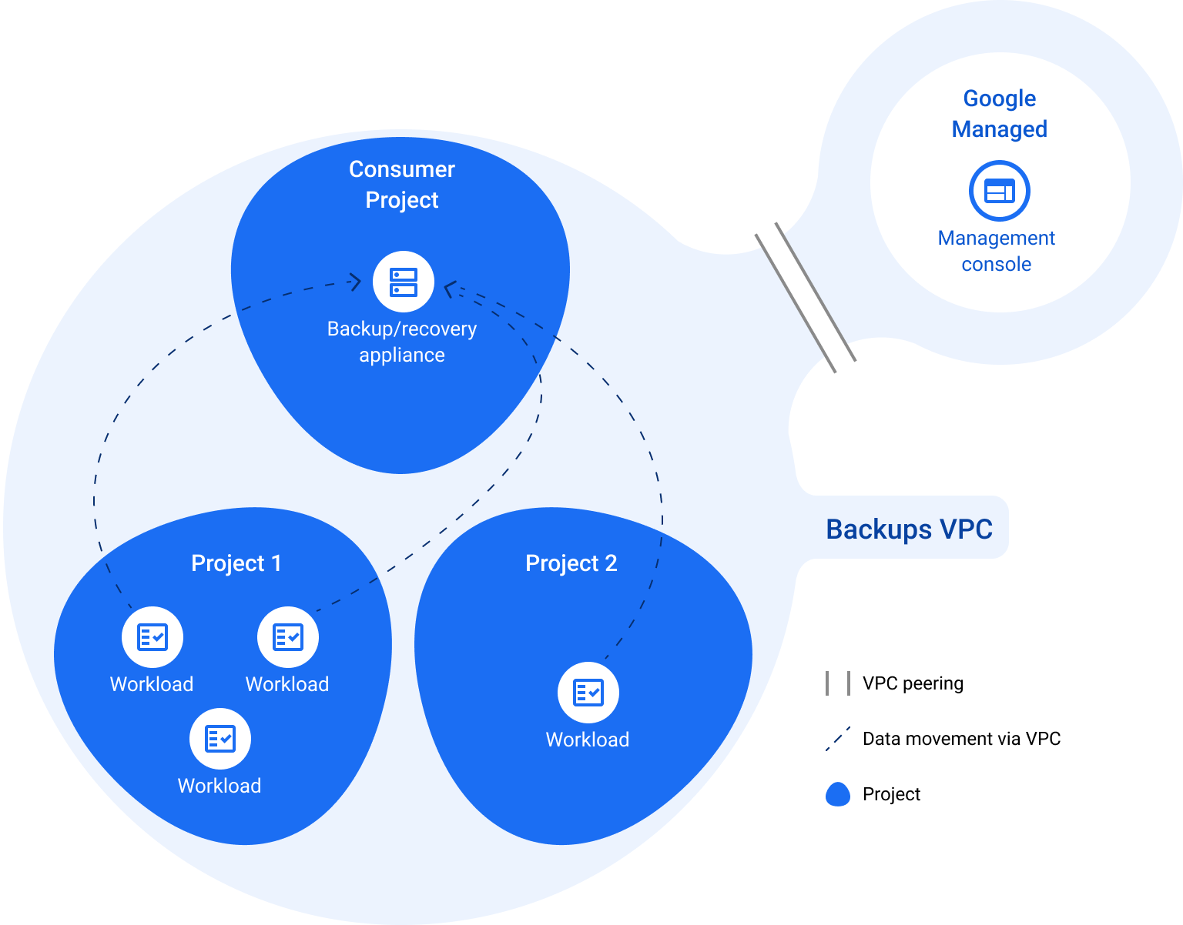
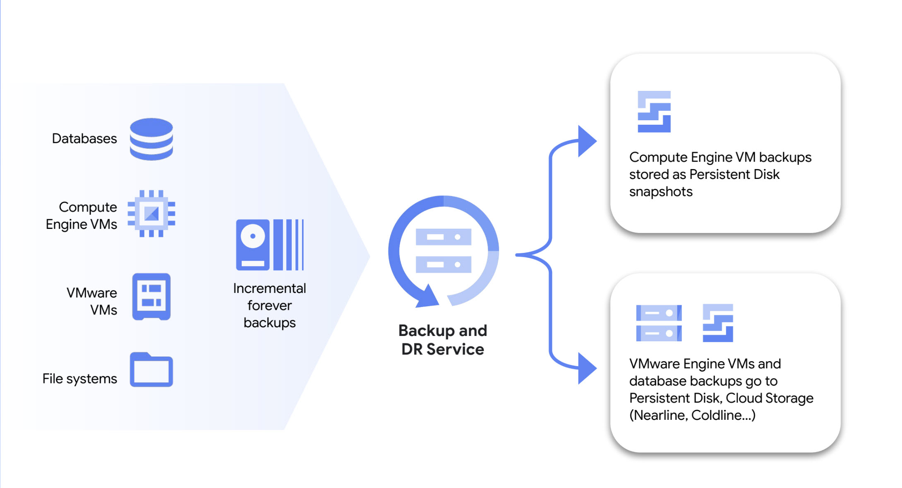
GCP - Backup and DR Service
Components of the Backup and DR Architecture
Management console
Backup/recovery appliances
Backup and DR agents

Slide 51
Q & A

Slide 52
Task

Slide 53
Tasks
Perform migration of 3 tier application (assess to migration) with Azure Migrate:
Create 3 VMs in one region and deploy some sample application
Do Assessment of migration of all 3 tier application(3 VMs of Servers)
Migrate all the servers to another region
Verify application is accessible from migrated region
Pipeline migration:
Source: GitLab
Destination: GitHub
Disaster Recovery:
Azure Site recovery and backup

Slide 54
Thank You

